Slide 1
CLINTON SAVIOUR HANOCH
HEALTHCARE PROVIDER FINANCIAL analysis REPORT

Slide 2
Table of content
Statement of Problem
Aims and objectives
Research questions
Dashboard report
Key insights and explanations
Conclusion
recommendations

Slide 3
Statement of the problem
The healthcare organizations often struggle to maintain financial sustainability while delivering efficient, quality care. Limited visibility into financial metrics and provider performance can hinder operational improvements. The lack of a centralized analytical tool makes it challenging to monitor billing patterns, manage healthcare costs, and evaluate departmental or provider contributions . Therefore, a data-driven approach is needed to analyze and visualize key financial and operational indicators within the healthcare setting.

Slide 4
Aims and objectives
Aim to analyze and visualize the financial and operational performance of a healthcare center using interactive dashboards, with a focus on billing trends, cost distribution, provider efficiency, and geographic insights.
Objectives
To assess the overall financial health of the healthcare center by analyzing billing amounts, treatment costs, and patient charges.
To evaluate provider and departmental performance based on billing contributions, procedure types, and service categories.
To identify key trends and patterns in healthcare delivery by examining time-based and categorical variations in data.
To uncover geographic differences in billing behavior and service utilization across cities or states.
To develop an interactive dashboard that enables stakeholders to gain actionable insights for strategic decision making.

Slide 5
Research questions
What are the main cost drivers in the healthcare center’s operations(for example..., treatment, medication, room charges)?
How does billing varies across procedures, diagnosis and departments and which area generate the most revenue?
What trends can be observed in provider performance based on billing amount and patient service types(inpatients, outpatients and emergency)?
Are there geographic differences in total billing amount across cities or states in the uk?

Slide 6
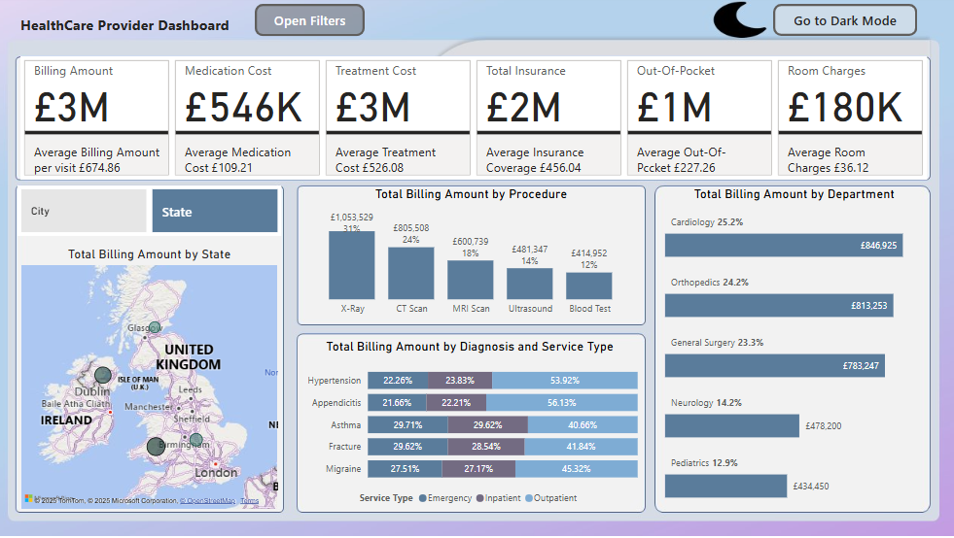
The healthcare provider dashboard light mode

Slide 7
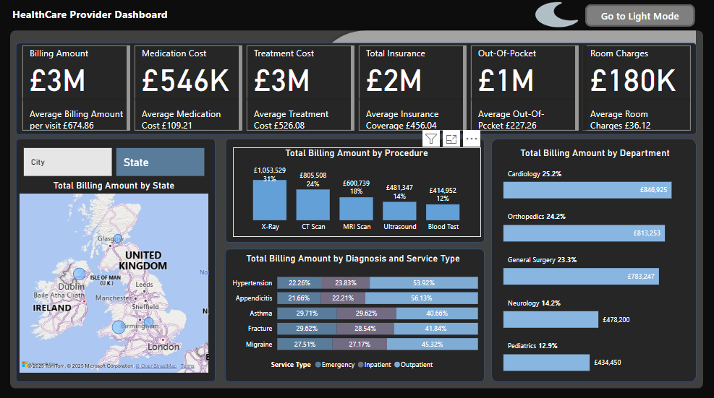
The healthcare provider dashboard Dark mode

Slide 8
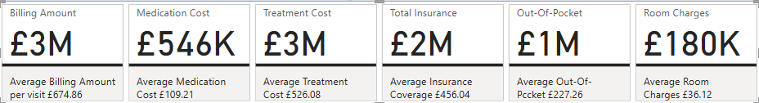
What are the main cost drivers in the healthcare center’s operations(for example..., treatment, medication, room charges)?
Kpis analysis insights and interpretation
Insight: Treatment services are the major cost and revenue driver. Insurance covers a large portion, but patients still pay a significant amount out of pocket. Medication and room charges are less impactful but should still be optimized for efficiency.

Slide 9
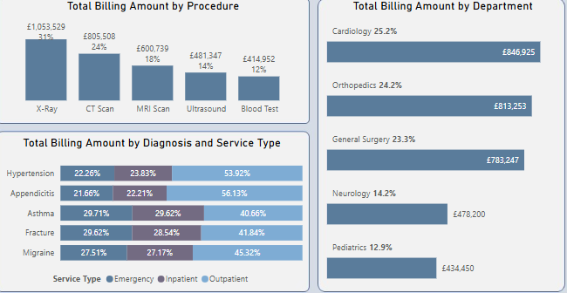
How does billing varies across procedures, diagnosis and departments and which area generate the most revenue?
Insights::
Procedure: The x-ray procedure accounts for over one-third of the billing, making it the most revenue generating service.
Diagnosis: diagnosis like Hypertension, appendicitis, and migraine are mostly billed as outpatients services.
Department: the cardiology department leads in total billing, reflecting a concentration of high value services in heart-related care.

Slide 10
What trends can be observed in provider performance based on billing amount and patient service types (inpatients, outpatients and emergency)?
Insights :
Providers are primarily engaged In outpatients care, especially for chronic and manageable conditions like hypertension and migraine. Acute or trauma conditions like fracture shift more towards emergency and inpatients care.

Slide 11
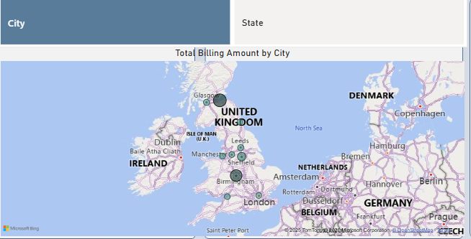
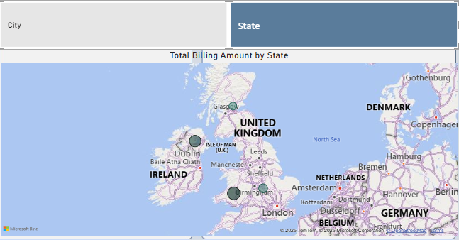
Are there geographic differences in total billing amount across cities or states in the uk?
Insights:
City: Edinburgh, Birmingham, and Sheffield contribute the highest billing amounts, indicating a concentration of services or larger patients bases in these areas. State: northern Ireland, Wales, and Scotland contributes the highest billing amount within the uk.

Slide 12
Simplified Recommendations
For Healthcare PROVIDER Financial Analysis

Slide 13
Make Treatment More Efficient
What this means: Right now, the hospital is spending all its money on treating patients — that’s where nearly all the income is going. This could be risky if treatments aren’t well managed.
What to do: Check how treatments are being given. Avoid doing the same test or treatment twice. Make sure doctors follow clear guidelines so patients get what they really need.
Why it matters: This helps save money, treat more people better, and avoid waste.

Slide 14
Don’t Rely Only on X-Rays for Income
What this means: Almost 35% of the hospital’s income comes just from X-rays. That’s a lot from one service. If fewer people need X-rays tomorrow, that’s a big loss.
What to do: Start promoting other services like CT scans, surgeries, or ultrasound to bring in more money from different places.
Why it matters: It spreads the income so the hospital doesn't lose too much if demand for X-rays drops.

Slide 15
Help Doctors in Emergency & Inpatient Departments
What this means: Some health issues like bone fractures need emergency or hospital stays. That puts extra pressure on those doctors and nurses.
What to do: Make sure these teams have enough staff, equipment, and support — maybe even rotate staff so no one gets overwhelmed.
Why it matters: It improves the quality of care and avoids staff burnout.

Slide 16
Reach Out to Cities with Fewer Patients
What this means: Big cities like Birmingham bring in lots of money, but other places aren’t using the hospital as much.
What to do: Let people in smaller cities know what services are available. Maybe set up mobile clinics or partner with local centers.
Why it matters: It helps more people get care and increases the hospital’s income from new areas.

Slide 17
Make It Easier for Patients to Pay
What this means: Even though many patients have insurance, they still pay a lot from their pockets — about £1 million total. That can be hard on them.
What to do: Offer flexible payment plans, discounts, or help patients get better insurance options.
Why it matters: More patients will be able to afford care, and they’ll be more likely to come back in the future.

Slide 18
Thank you!
Clinton SAVIOUR HANOCH

